Slide 1
Tokugawa Shogunate & its downfall
Saumya Bose
Department of History

Slide 2
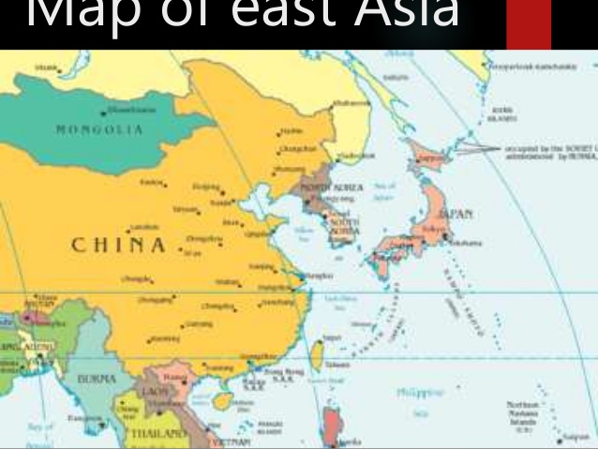

Slide 10
